Slide 1

Intelligent Course Recommendation and Guidance System
Guided by: Dr S K Saravanan
Course code: CSA-0203
Course name: C Programming
Presented by
R K Kamalanathan(192512158)
M Guru Pranesh (192512439)
B Revanth Reddy(192524289)

Slide 2


INTRODUCTION
The Intelligent Course Recommendation and Guidance System is an AI-based platform designed to help students select suitable academic courses according to their interests, skills, academic performance, and career goals.
Many students face confusion while choosing subjects due to a lack of proper guidance.
This system uses data analysis to provide personalized course recommendations and academic guidance.
The project also includes performance analytics to monitor student progress and identify strengths and weaknesses

Slide 3
Problem Identification and Analysis
Lack of personalized academic guidance
Limited access to professional counseling
Poor analysis of student interests and abilities
To overcome these challenges, an intelligent automated system is required to analyze student data and provide accurate course recommendations and guidance.

Slide 4
Solution Design and Implementation
The proposed solution is an AI-based recommendation and guidance system developed using javascript,HTML,css3 and c programming. The system is designed to collect student information, process academic data, and generate personalized suggestions.
JavaScript (ES6+): The core programming language used for all the logic (calculating GPA, the AI Elective Matcher, prerequisite checking, and graph rendering).
HTML5: Used for the structural foundation of the application.
CSS3: Used for styling, smooth animations, and the Light/Dark mode theme engine.

Slide 5
Module 1: Recommendation Engine
The Recommendation Engine Module is the main component of the Intelligent Course Recommendation and Guidance System
This module is designed to analyze student information such as academic performance, interests, skills, and career goals to provide personalized course recommendations.
Based on the analysis, the system suggests suitable courses.
Functions of Recommendation Engine:
Collects student academic records and interests
Analyzes skills and performance levels
Recommends suitable courses and learning paths
Matches courses with career opportunities

Slide 6
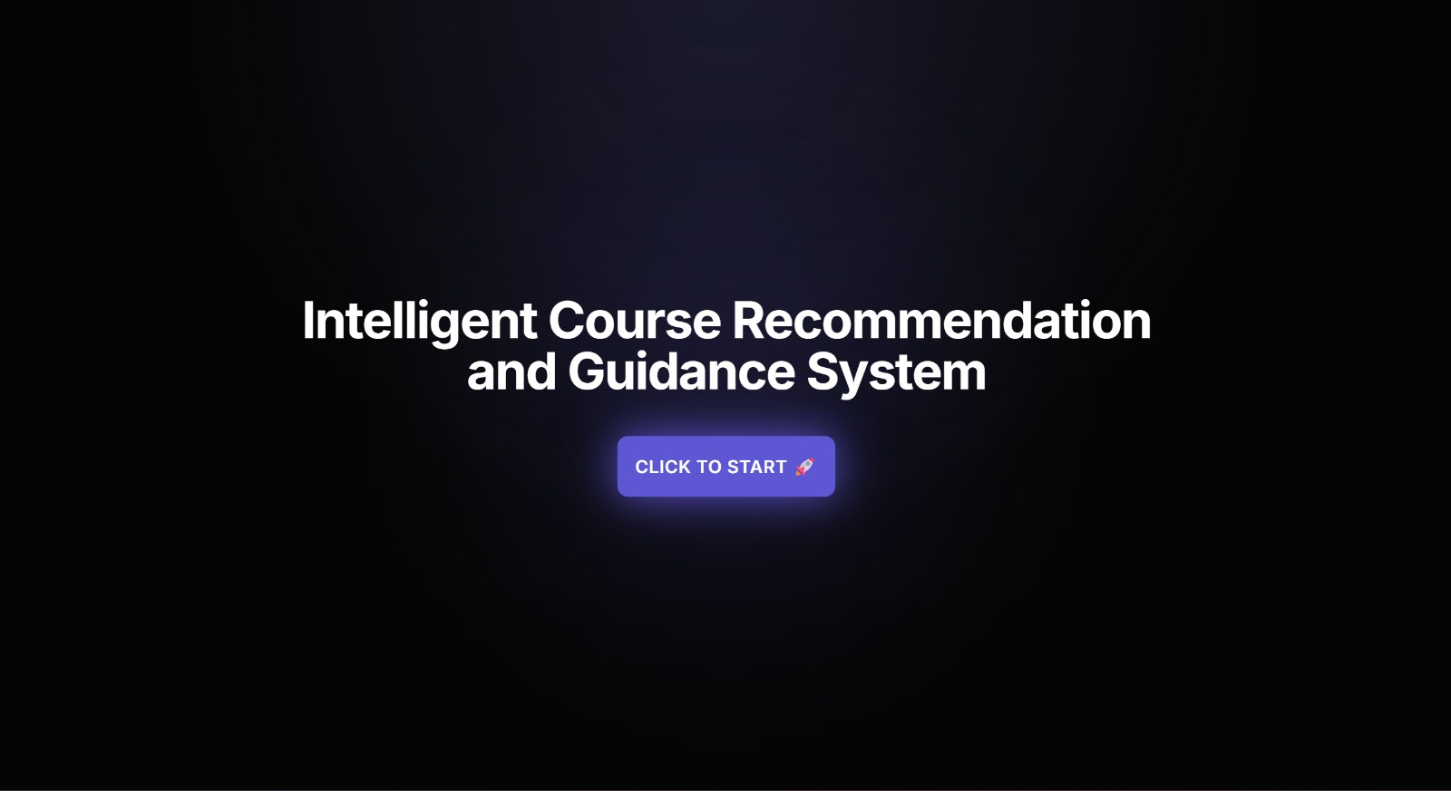

Slide 7
Module 2: Student Guidance
The module supports students by giving useful suggestions and helping them understand their strengths, weaknesses, and future goals.
It also helps students track their academic progress and improve their learning performance.
Functions of Student Guidance Module:
Provides academic counseling support
Tracks student learning progress

Slide 8
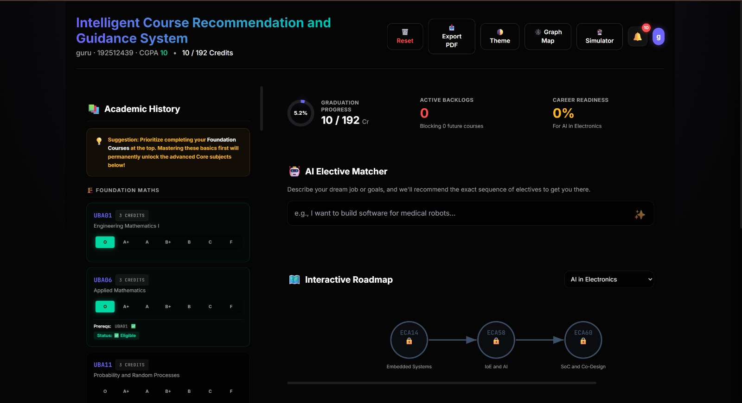

Slide 9
Module 3:Performance Analytics Module
The Performance Analytics Module monitors and evaluates student performance.
It helps students and educators understand learning progress and identify areas for improvement.
Features:
Tracks academic performance
Identifies strengths and weaknesses
Provides performance insights
This module improves learning outcomes by helping students focus on weak areas and improve their academic performance.

Slide 10
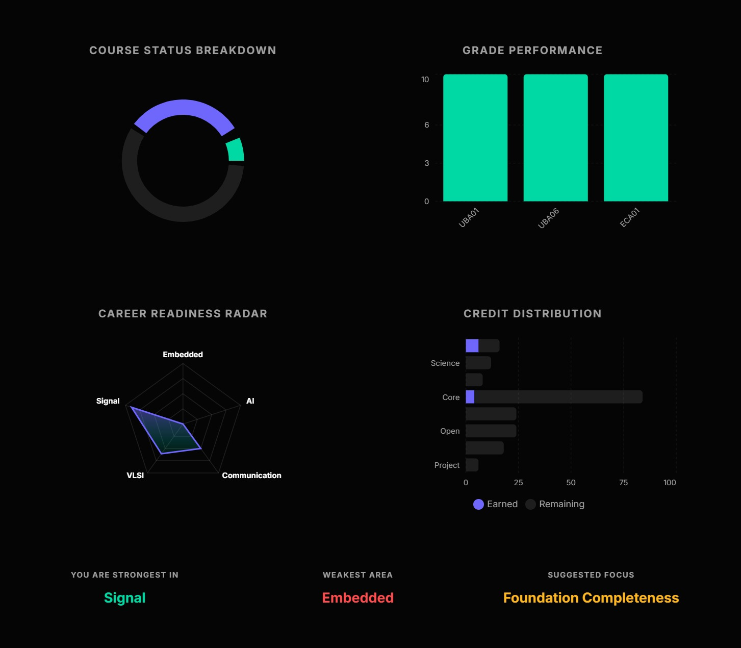

Slide 11
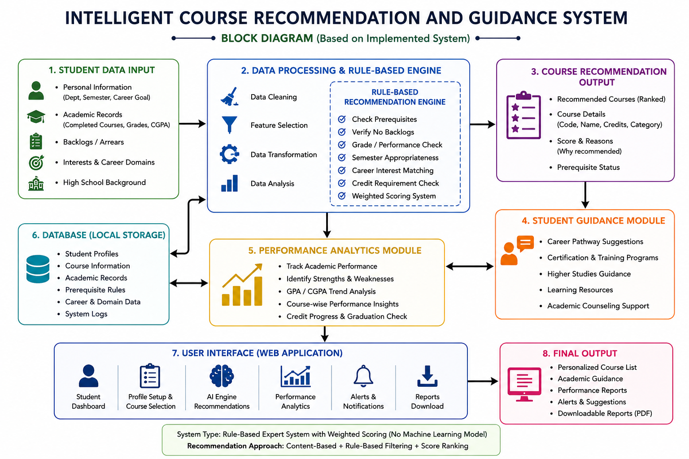

Slide 12
Results and Discussion
The developed system successfully generated personalized course recommendations based on student data.
The recommendation accuracy improved academic decision-making and reduced confusion in course selection.
Students received better academic support, career suggestions, and performance analysis.
The integrated modules improved the overall efficiency of the system and provided a user-friendly experience.

Slide 13
Conclusion
The Intelligent Course Recommendation and Guidance System is an effective AI-based solution that supports students in choosing suitable academic courses and planning their careers.
The system provides personalized recommendations, academic guidance, and performance analysis using intelligent technologies
By integrating modules, the project improves decision-making, reduces confusion, and enhances learning outcomes.
This system can be further expanded with advanced AI techniques and real-time educational data to provide even more accurate and efficient guidance in the future.

Slide 14
References
Frej, J., Dai, A., Montariol, S., Bosselut, A., & Käser, T. (2024). Course recommender systems need to consider the job market. arXiv.
Esteban, A., Zafra, A., & Romero, C. (2024). Helping university students to choose elective courses by using a hybrid multi-criteria recommendation system with genetic optimization. arXiv.
Xu, Z., Yamamoto, S., & Joho, H. (2025). Research paper recommender system by considering users' information seeking behaviors. arXiv.
Soni, R., Suleiman, B., & Singh, S. (2025). Improving graduate outcomes by identifying skills gaps and recommending courses based on career interests. arXiv.
Adomavicius, G., & Tuzhilin, A. (2024). Toward the next generation of recommender systems: A survey of the state-of-the-art and possible extensions. ACM Transactions on Information Systems.

Slide 15


